Slide 1
Intro to Cloud Computing

Slide 2

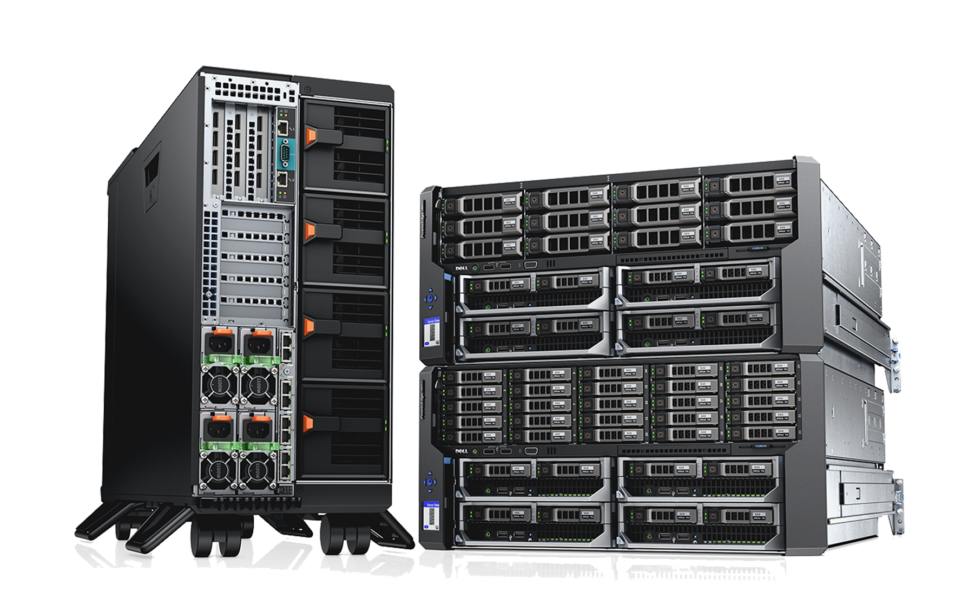


Before Cloud Computing existed,
Before cloud computing, there was a guy named Totskie who wanted to build a website for his business. To do this, he would need to invest in a server, hardware, software, and experts to set everything up. This was expensive and time-consuming. This traditional approach is called on-premise.

Slide 3

One day, Totskie met Browskie, who introduced him to the idea of cloud computing. Browskie explained the many benefits of the cloud:

Slide 4
Cost Efficiency: Cloud computing eliminates the need for businesses to heavily invest in physical hardware and on-site infrastructure. Instead, businesses can pay for only the services they use, making it a much more affordable option.
Accessibility & Flexibility: Cloud services are accessible from anywhere with an internet connection, which is perfect for remote work and collaboration. This is especially beneficial for businesses with teams spread across multiple locations.
Reliability and Redundancy: Cloud providers offer high availability, ensuring that services are backed up, fault-tolerant, and accessible even during outages.
Convinced by these advantages, Totskie was intrigued by the cloud but still curious about how it works.

Slide 5


Cloud computing is essentially using computing resources, such as storage and processing power, through the internet instead of relying on your personal computer or local hardware. Rather than storing data or running applications on your own device, you connect to powerful remote servers that handle everything for you.

Slide 6
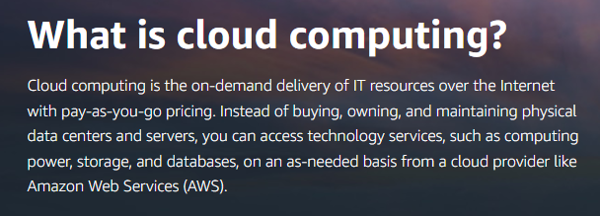

Slide 7
Cloud Deployment Models
Public Cloud: Owned and operated by third-party providers, where resources are shared among multiple users (e.g., AWS, Microsoft Azure, Google Cloud).
Private Cloud: Dedicated to a single organization, offering greater control and security (e.g., Facebook's internal cloud).
Hybrid Cloud: Combines elements of both public and private clouds, allowing businesses to share data and applications between them for enhanced flexibility and efficiency. An example of a hybrid cloud is NASA, which uses a combination of public cloud services for data storage and computing, while maintaining private clouds for more sensitive data and mission-critical operations.

Slide 8
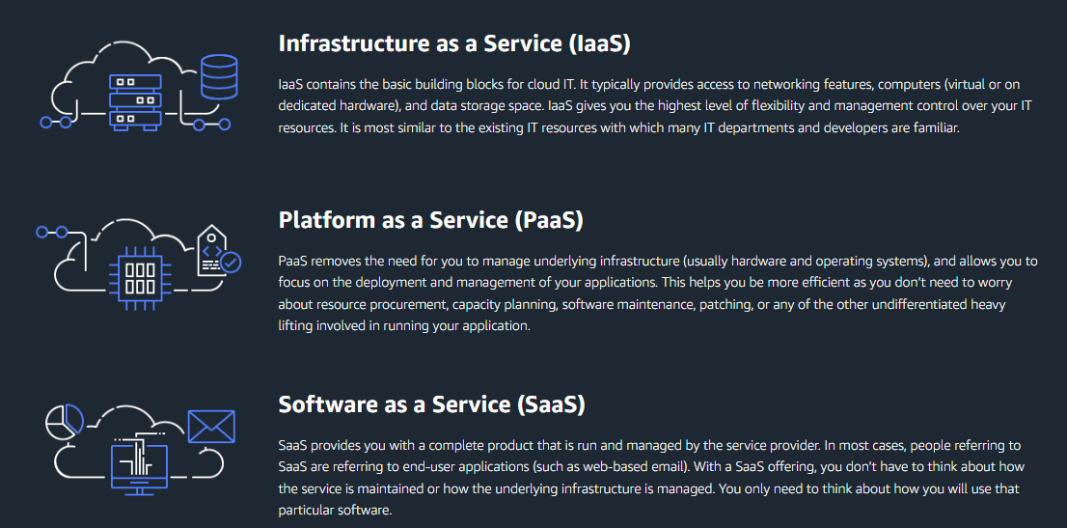
Types of cloud computing

Slide 9
Type | You Manage | Provider Manages
IaaS | OS, apps, data | Servers, storage, networking
PaaS | Apps, data | OS, runtime, infrastructure
SaaS | Just usage | Everything

Slide 10


